Slide 1


#LifeKoKaroLift
Lecture 0:
Statistics & EDA- INT351
1

Slide 2



Module Name:
1. STATISTICS & EDA
Instructor :
Shivangini Gupta
2

Slide 3
Course Outcome
CO1 :: Understand the basic concepts of exploratory data analysis.
CO2 :: Apply the univariate techniques on the data to analyze it.
CO3 :: Apply the concepts of probability and distribution to depicts the expected outcomes of possible values for a given data.
CO4 :: analyze the large number of samples from a given population and establish a stronger
grasp on the understanding of a population.
CO5 :: understand and apply the hypothesis testing on a given data set.

Slide 4

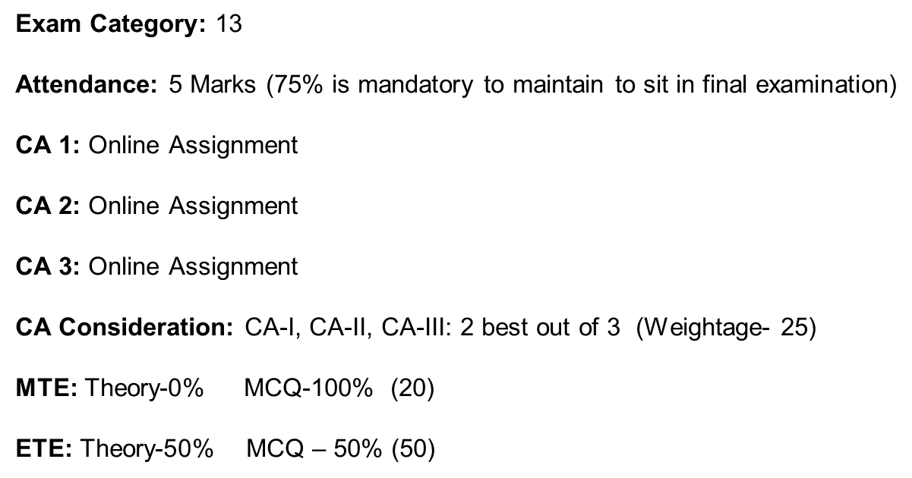
Statistics & EDA – INT351

Slide 5

Course Content:
EDA
Univariate Analysis
Inferential Statistics - I
Inferential Statistics - II
Hypothesis Testing
Hypothesis Formulation
Data Science Certification Program
5

Slide 6



Python- Print a list of square of numbers from 1 to 100.
notebook
Practice in teams of 4 students
Industry expert mentoring to learn better
Get personalised feedback for improvements
23/05/19
11
Footer
6

Slide 7

EDA
Introduction to EDA,
Public and private data,
Web Scraping,
Data Types,
Fixing the rows and columns,
Impute/remove missing values,
Handling outliers,
Standardizing values,
Fixing invalid values and filter data
Notes:
Additional resource : https://www.guru99.com/data-warehousing.html

Slide 8

Univariate Analysis
Introduction to univariate analysis,
Categorical unordered univariate analysis,
Categorical ordered univariate analysis,
Statistics on numerical features,
Numeric - numeric analysis,
Correlation vs causation,
Numerical - categorical analysis, categorical - categorical analysis,
Multivariate analysis,
Missing values,
Correlation and causation,
Data visualization

Slide 9
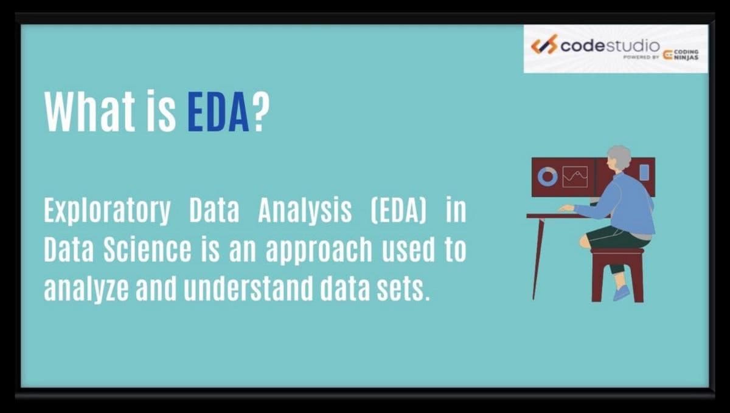

Slide 10
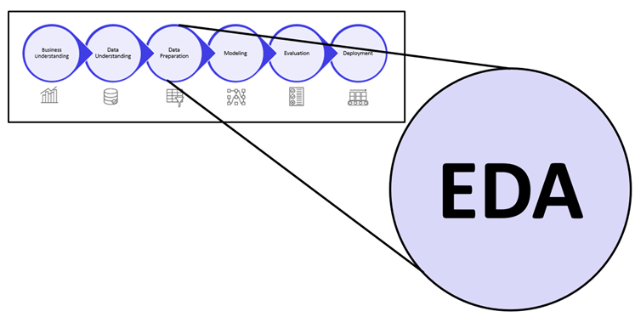

Slide 11
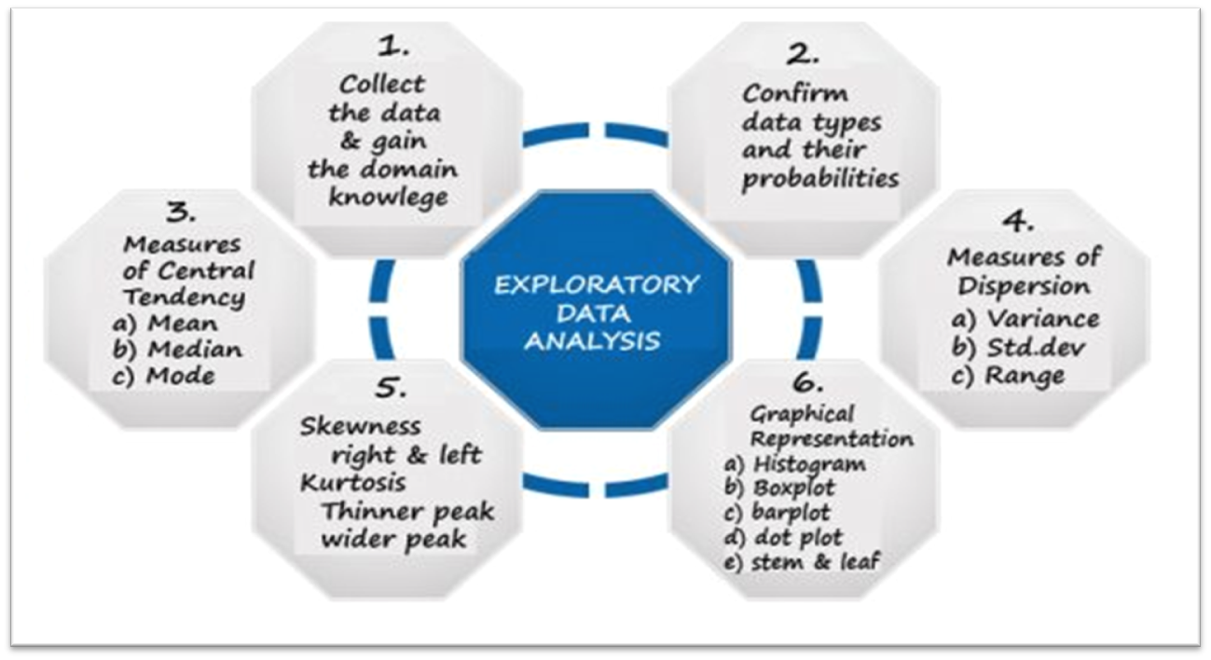

Slide 12
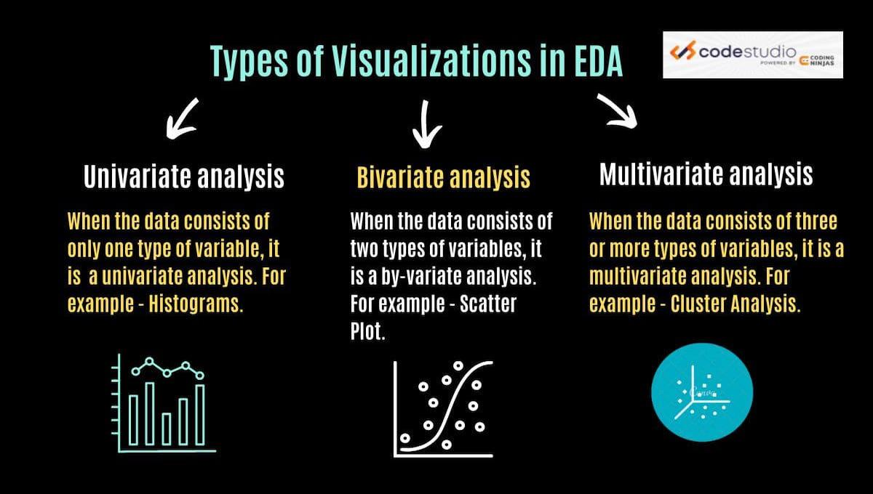

Slide 13
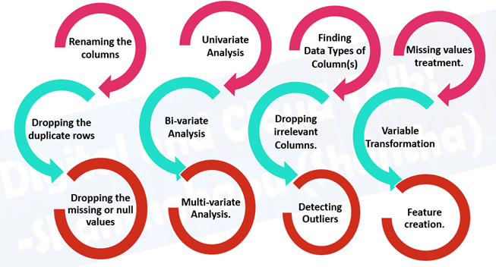

Slide 14
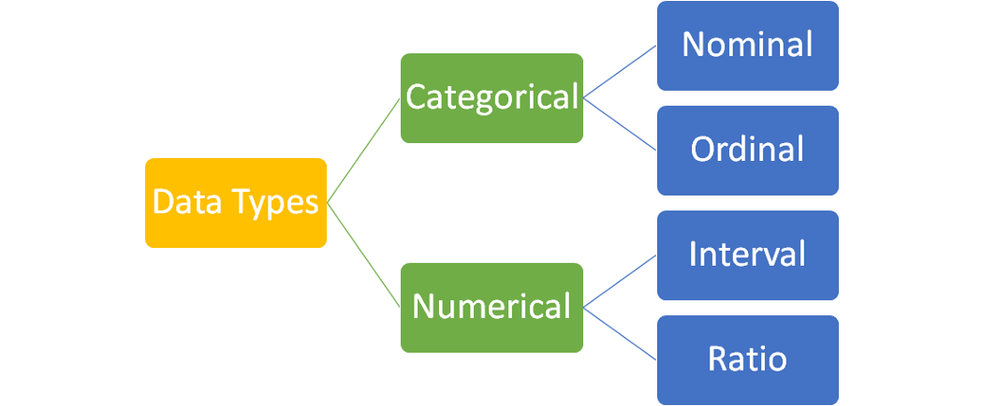

Slide 15
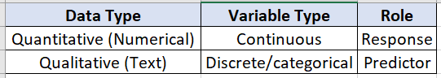
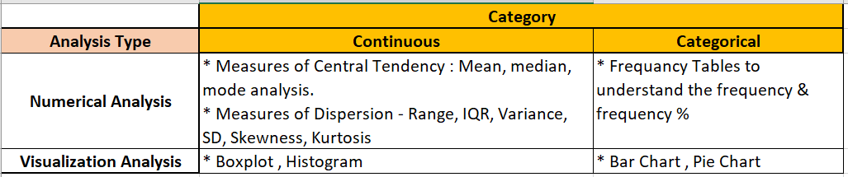

Slide 16
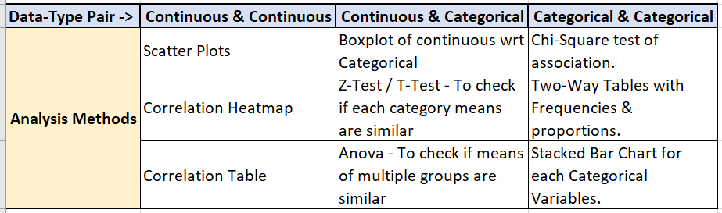

Slide 17
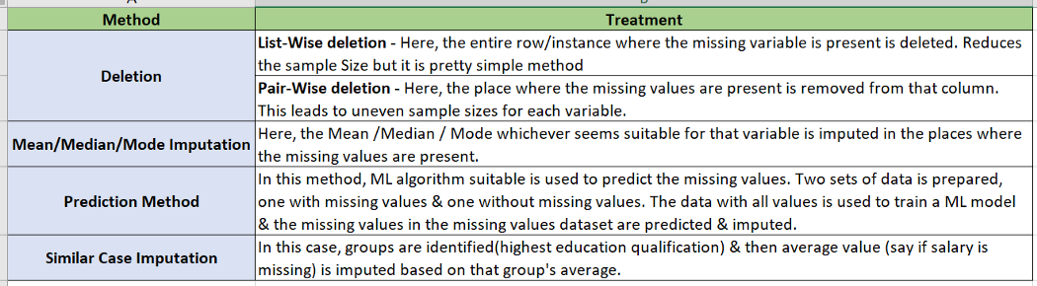

Slide 18
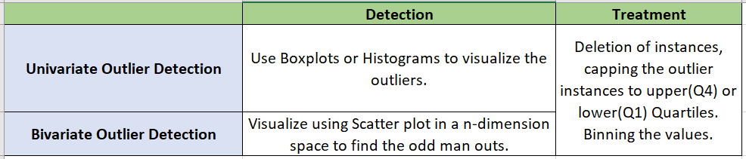

Slide 19
#LifeKoKaroLift
Thank You!
19

